Slide 1
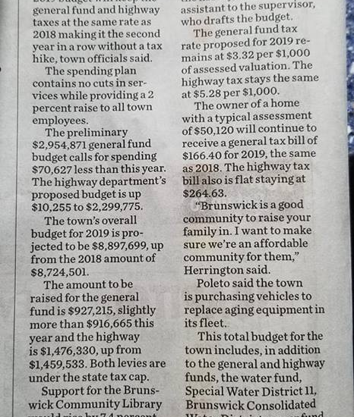
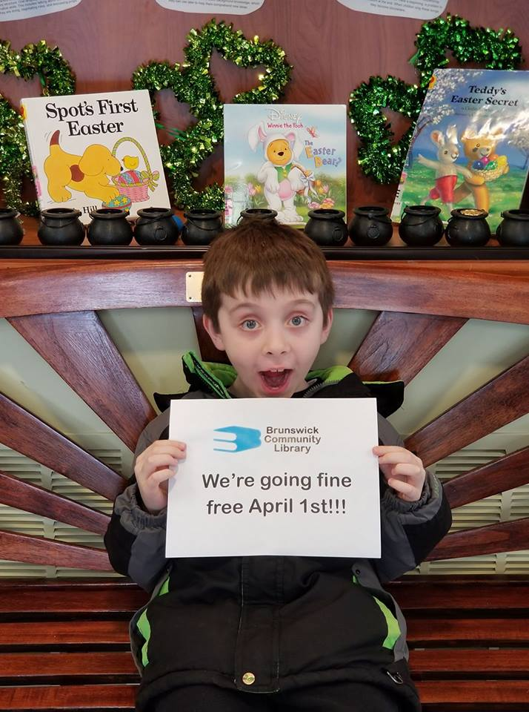
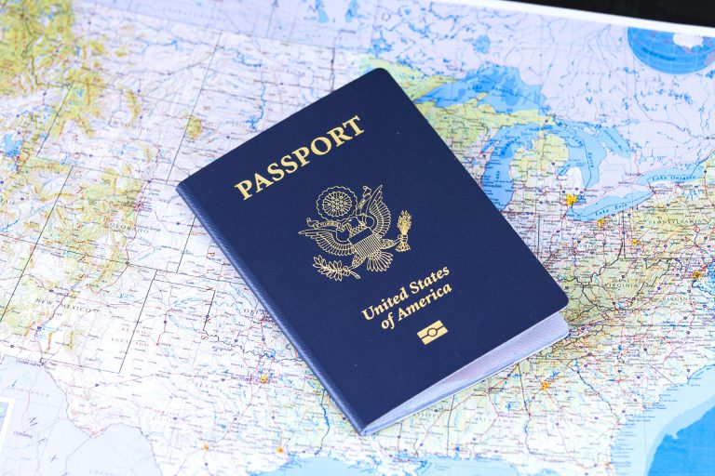
Brunswick Community Library
2018 Annual Report: A year to remember

Slide 2
But first…the stats
We circulated 42,065 items, including books, magazines, audio books, DVD’s, music CDs, and large print books. A 11.4% increase from last year!
We circulated 11,915 electronic items including digital movies, digital audio books and ebooks. A 15.1% increase from last year
We have 3,676 Brunswick card holders. A 8.7% increase from last year!
We served 29,857 patrons. A 12.1% increase from last year!

Slide 3
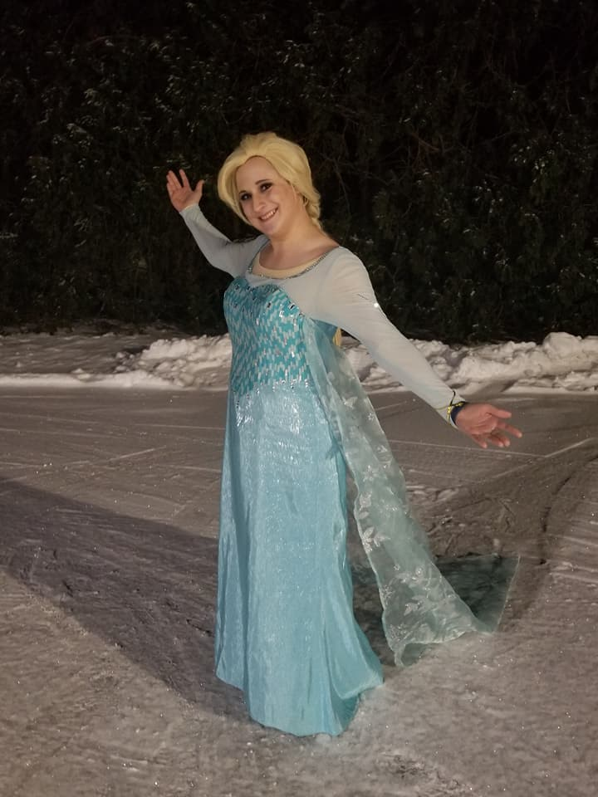
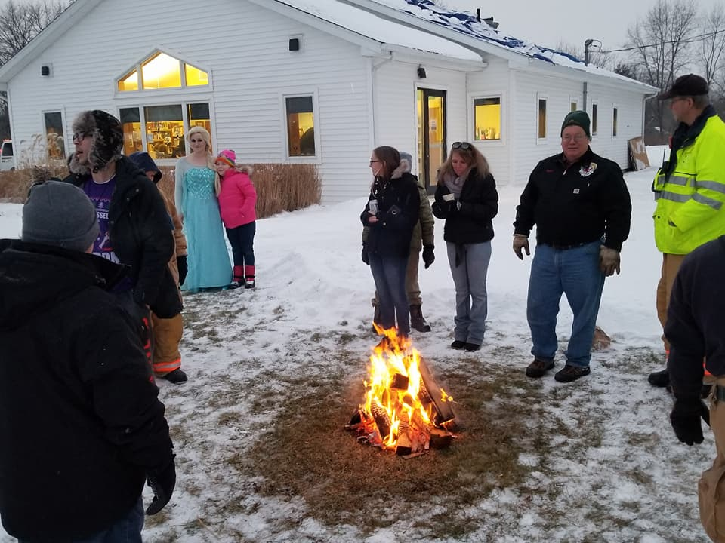
January & February
MOU with Grafton
BCL Library Lights
BEEP
Paint and Pizza Parties
Snow Days!

Slide 4
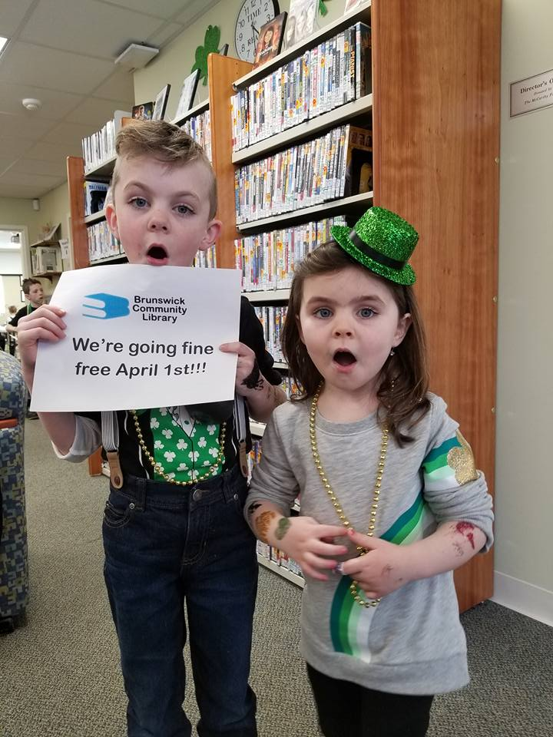

March & April
St Patrick’s Day Party
Egg Hunt
Fine Free
Long Range Planning
McCarthy Grant $6,000!
Stewart’s Donation $700!
Bursik Donation $1000!
Roof repair

Slide 5
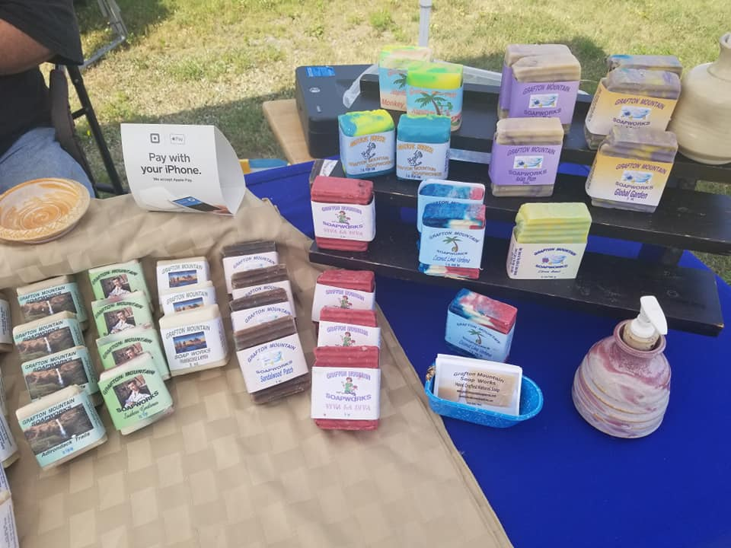
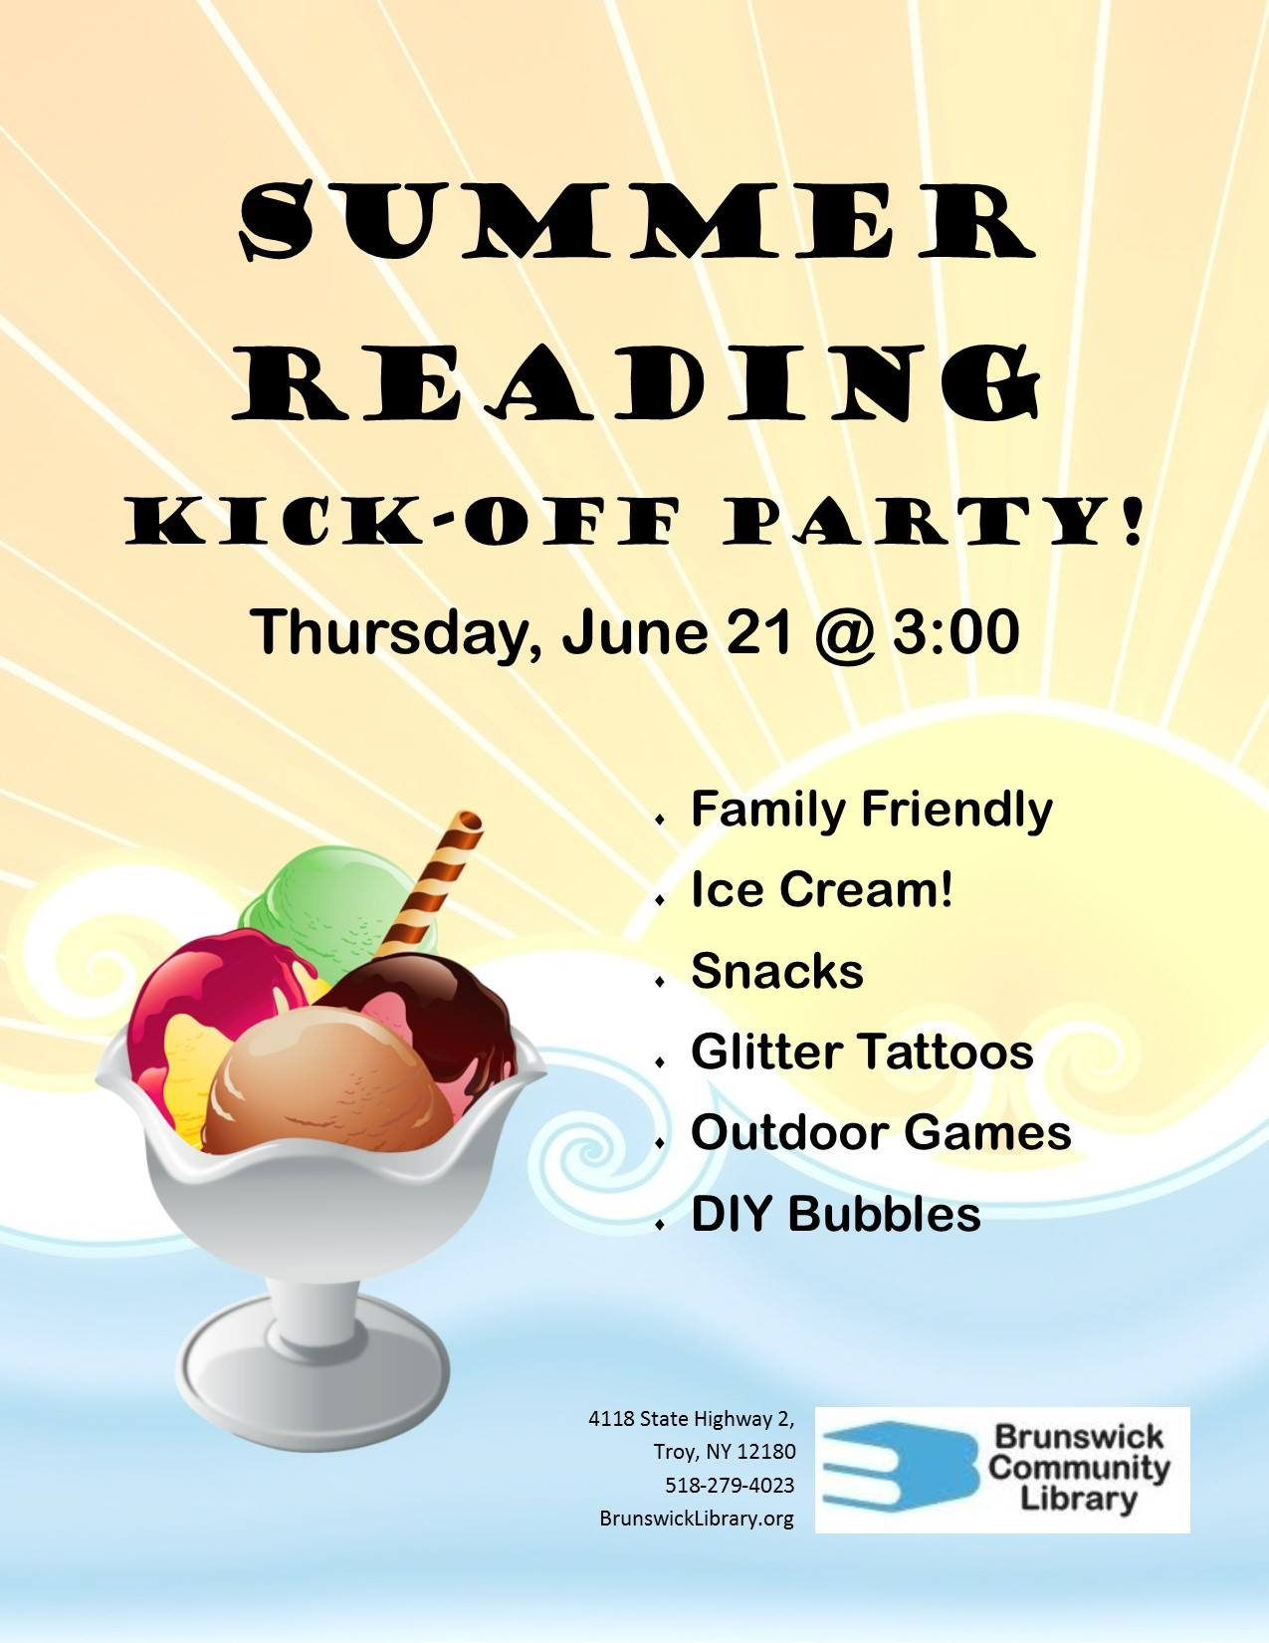
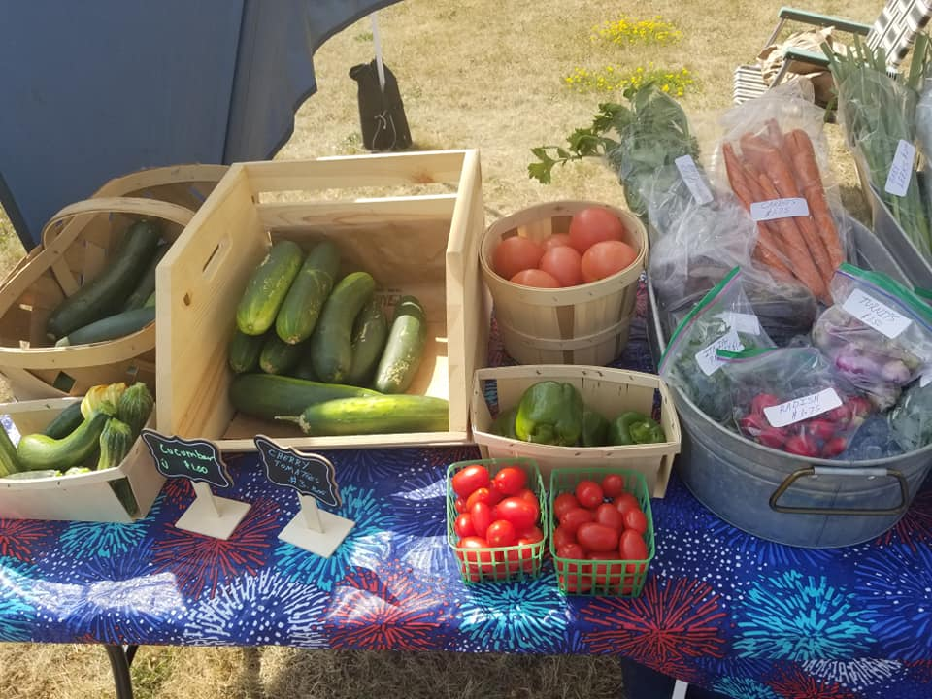
May & June
Chamber of Commerce
Summer Reading Program
Farmer’s Market
No more book sales ☹
Jumping Worm ☹
AARP Driver Safety Course

Slide 6
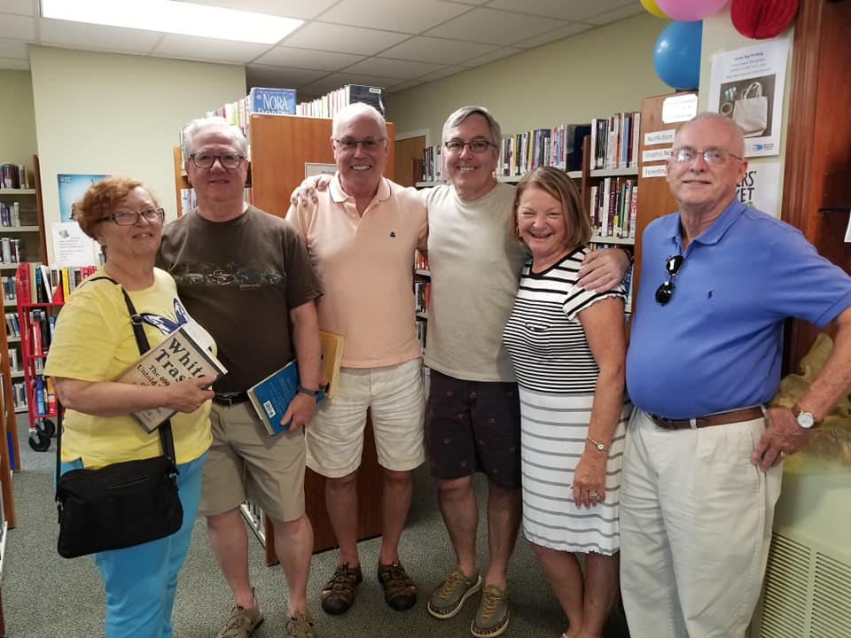
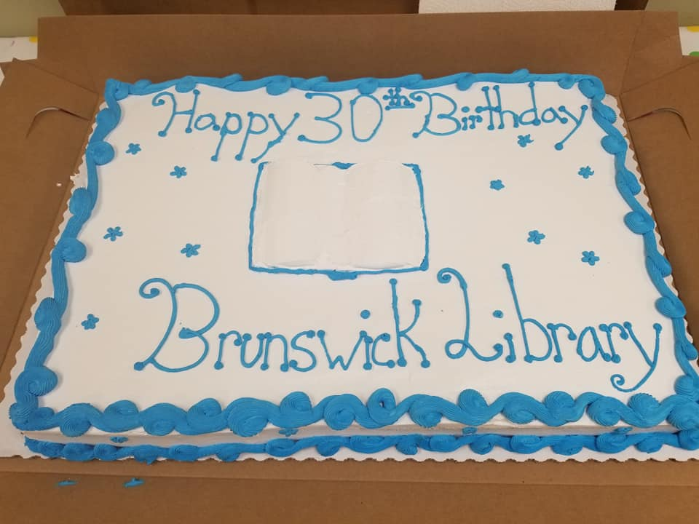
July & August
30th Birthday Bash
Summer Reading Program
Farmer’s Market

Slide 7
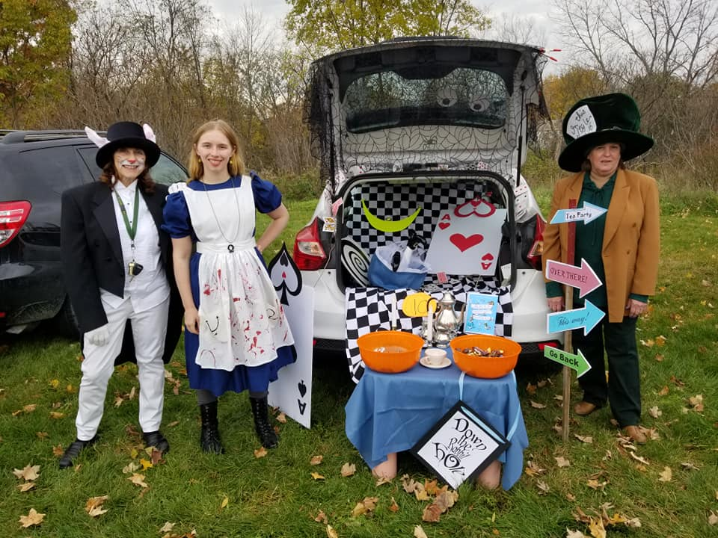
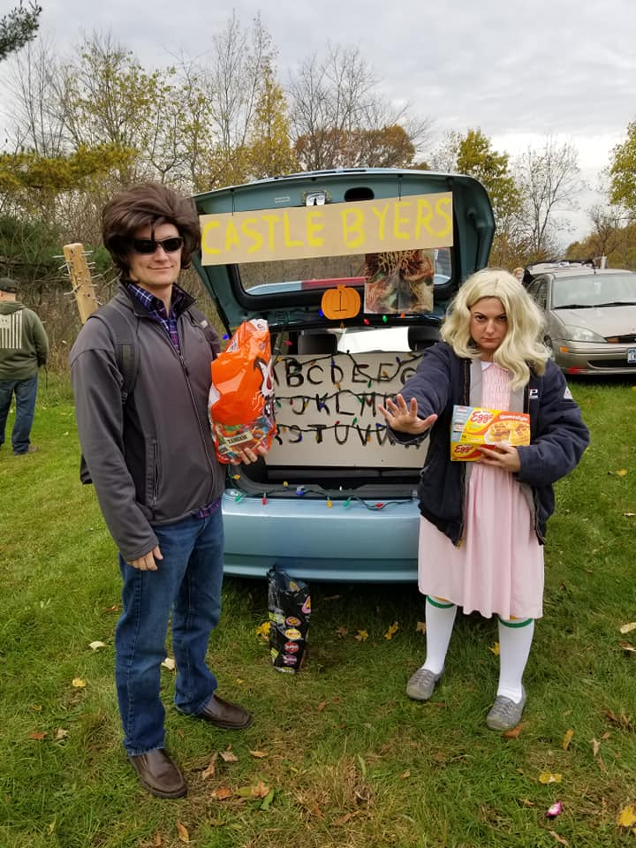
September & October
Upper Hudson Library 36er Expedition
Apple Cider Social
Passports
Fall Fest
Halloween
Trunk or Treat

Slide 8
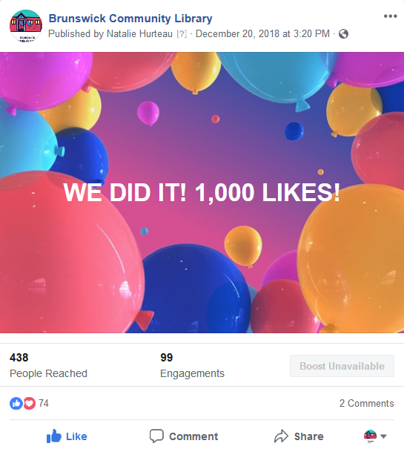
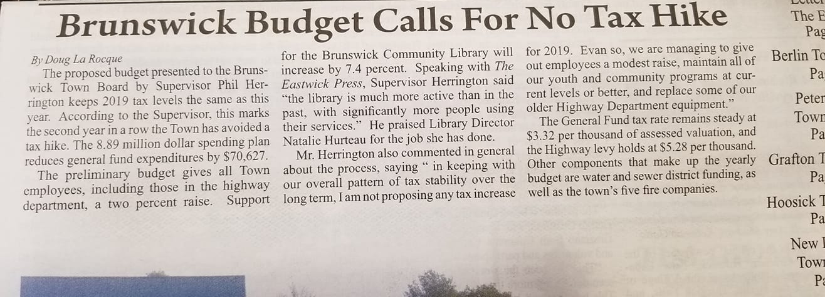
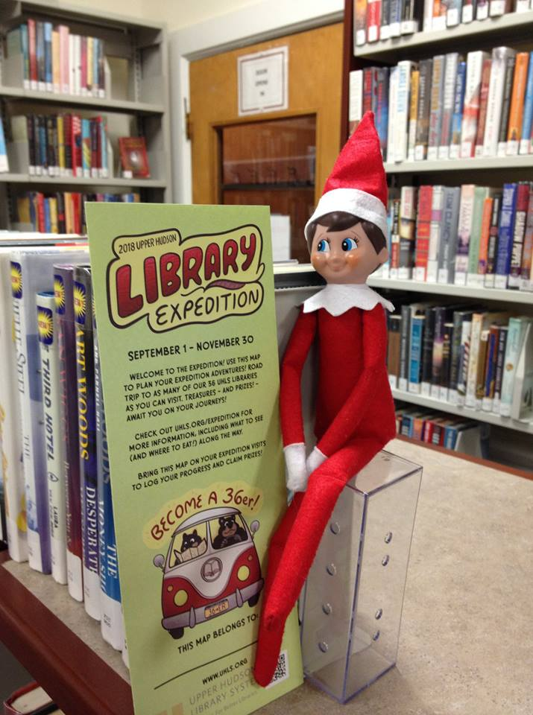
November & December
Annual Appeal
Town Increase
Craft the Holidays!
1,000 Likes on Facebook!
Dewey’s Expedition
Sophia goes to HVCC Library
End of Grafton MOU

